Slide 1
State of the Union
Oct 2009 – Oct 2010
Nick Airdo
Developer
Central Christian Church
Email: nick.airdo@cccev.com
Twitter: @airdo

Slide 2
Where Were We?
100% dependent on the Arena Community Server
A difficult to use Wiki
A difficult to admin code repo (CVSDude)
A cumbersome module market/store
An new IRC channel but w/ limited participation

Slide 3
Where Are We?
open source s/w / project mgmt tool (Redmine)
Easy to manage SVN repository
Better wiki
Issue Tracker (per project!)
w/Forums
Two possible module installers:
Voracity Solutions Installer
HDC Packaging System

Slide 4
Where Are We?
Greater participation in IRC #ArenaChMS channel
Arena Select – getting closer to target (more on this later)
RefreshCache conference ~ Double last year’s participation
94 shared reports
60 shared modules

Slide 5
Module Sharing
Still some a bunch of stuff being shared with limited details
Examples…
Please note: I’m not picking on one person – we’re all guilty of this problem

Slide 6
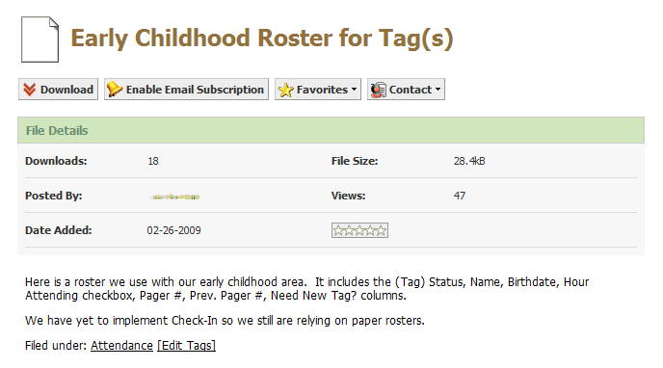
Example #1
Please note: I’m not picking on one person – we’re all guilty of this problem

Slide 7
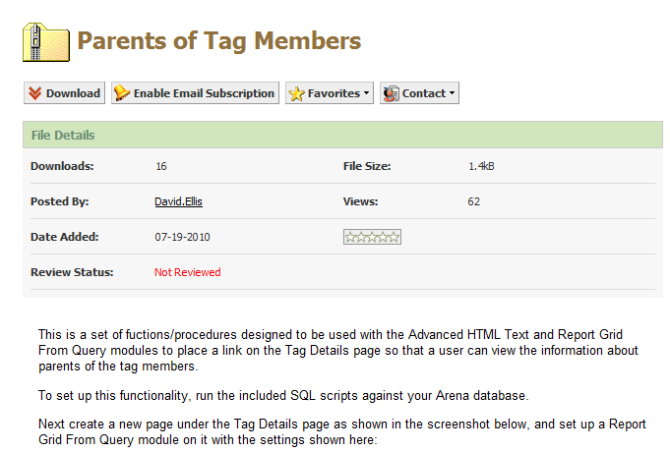
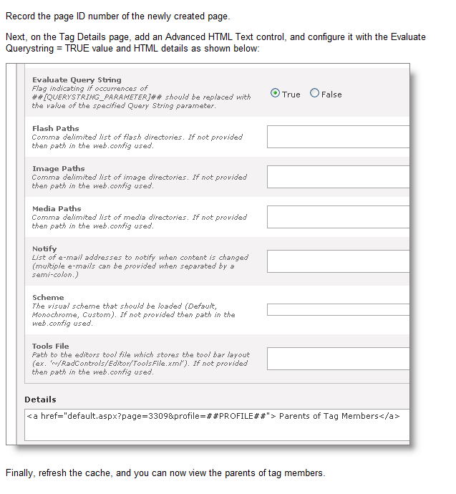
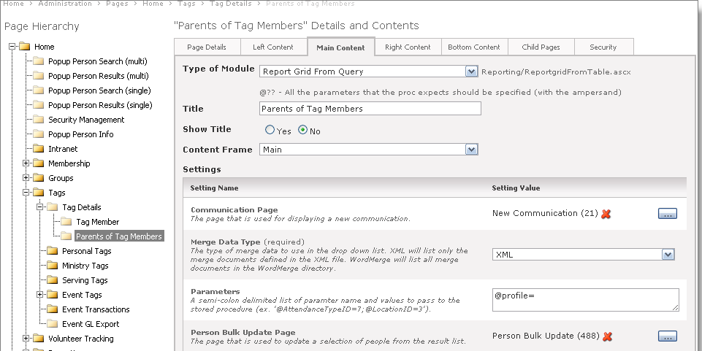
Example #2
Good Job David Ellis!

Slide 8
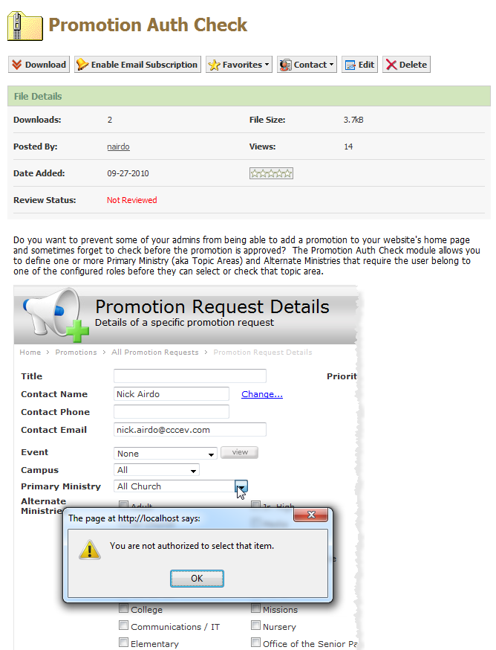
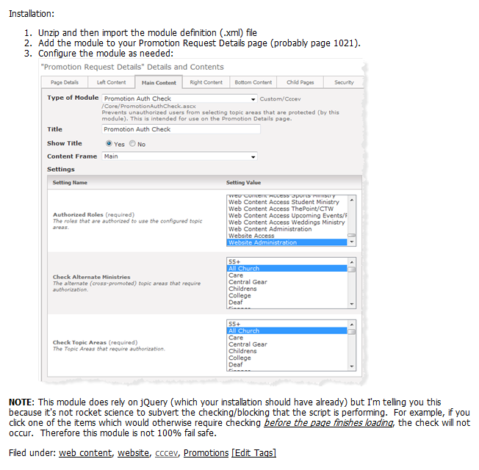
Example #3

Slide 9
A picture really is worth a 1,000 words

Slide 10
Where Are We Going?
Good question
Are we getting close to maxing out?
To some degree, I think the lack of a good “module marketplace” is contributing to slower momentum
Perhaps the new module packaging systems will help
Open Discussion?
…I also think there is huge 3rd party potential being missed

Slide 11
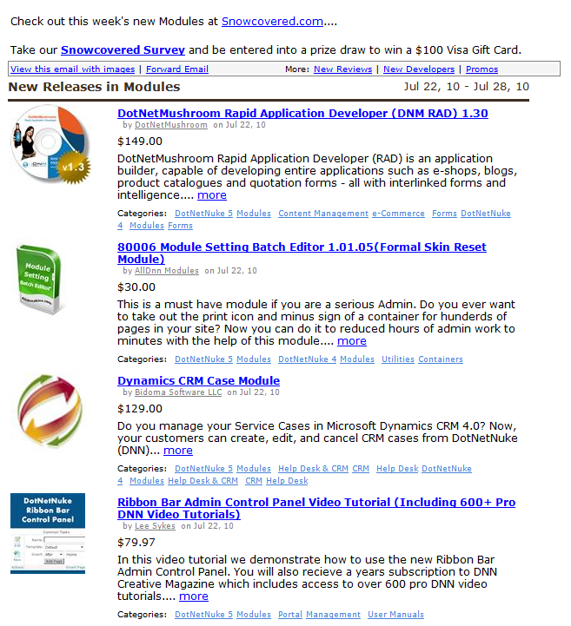
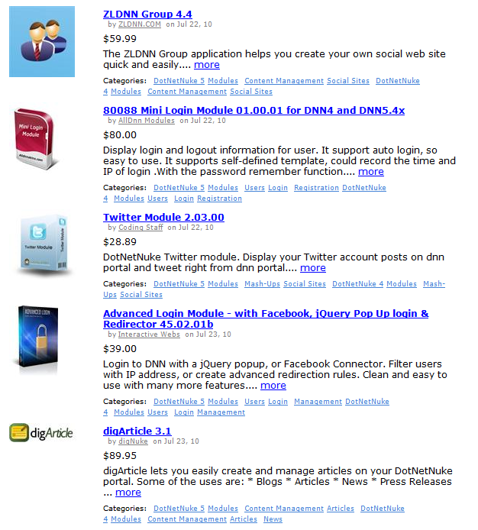
Example DNN Weekly Email

Slide 12
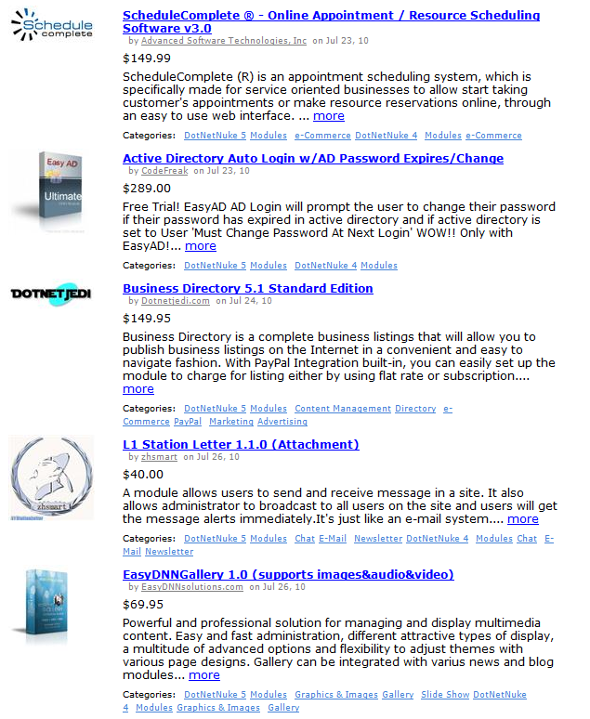
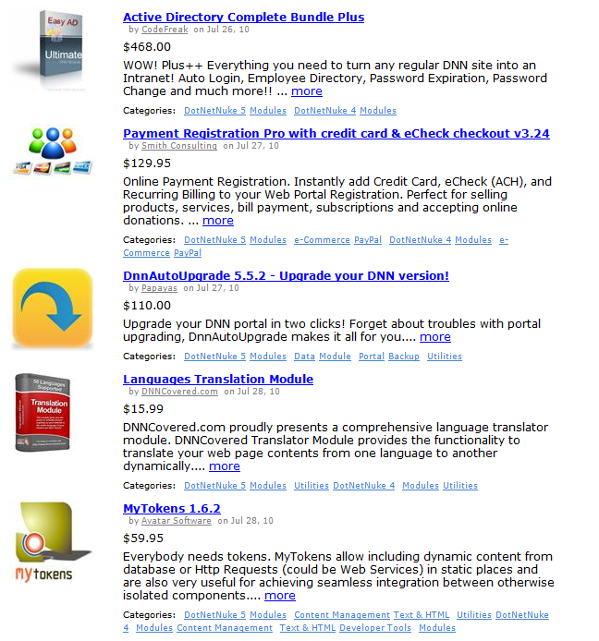

Slide 13
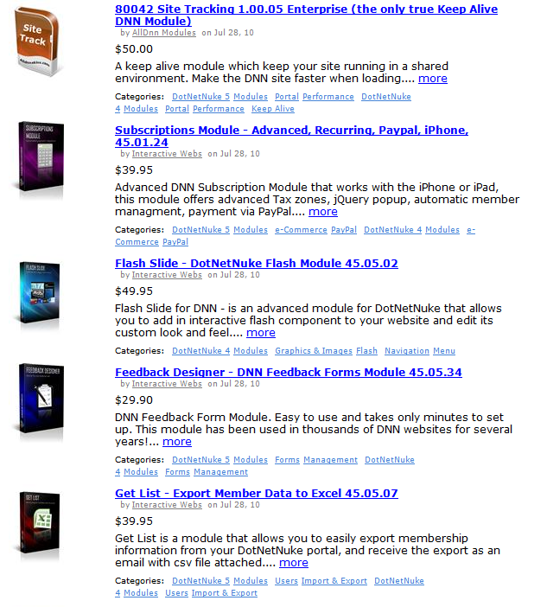
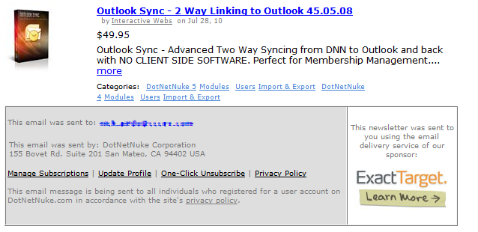

Slide 14
SnowCovered.com
More than 8,000 third-party add-ons for DNN

Slide 15
Where Are We Going?
We’d love to see an “Arena Core CMS” as real open source option
Besides the obvious and fantastic reasons such as:
Huge 3rd party potential
Access to small churches that have skilled volunteers (John Chandler, Dean Kuest, Brian Glass, etc.)
Arena could provide purchased support
Arena could create “premium” modules for a fee to those that want them – alleviates certain pressure from Arena sales team
Allows Arena to focus more on the “core” product (people, relationships, spiritual growth)

Slide 16
Less Obvious Reasons
Other open source developers can help improve parts of the product which are currently less important to Shelby/Arena Corp.
Opens the platform to other non-profits such as OneMission, OurHome Nepal, TOAG, etc.
(These are just the ones we’re working with – I’m sure others in the Arena community deal with many others.)
Notes:
The less important parts are still pretty important if you’re driving your website
I’m tired of using DNN and Wordpress as my open source *web application framework*
PHP is OK, but I really love .NET

Slide 17
Where Are We Going?
A few of us are looking at some open source CMS as a possible future ChMS foundation
If we go down that path we would initially begin spending our personal time working on the initiative
And later, possibly our normal work hours (pending approval of leadership, etc.)

Slide 18
Where Are We Going?
We’re not going away in the near future…
but the long term future looks open source.
Notes:
Doug Drinka, CCV, ShadeTree, SoChurch?

Slide 19
References
Redmine: http://redmine.org

